Slide 1
GAM 100 Project Introduction
Instructors
Justin Chambers
justin.chambers@digipen.edu
x4865
Office Hours:
Wed 10 AM – 2 PM
Matthew Picioccio
mattpic@digipen.edu
x5013
Office Hours:
Tues 10 AM – 12 PM
Wed 3 PM – 5 PM
Open Labs
Al-K M-Th 5 PM – 9:30+ PM
Lovelace Afternoons
Week 3 Lab
Introduction to Visual Studio

Slide 2

Introduction to Visual Studio (VS)

Slide 3
Introduction to Visual Studio
Tour of VS windows
Managing documents
Building/Running
Editing Features
Debugging Features
Build Configurations

Slide 4
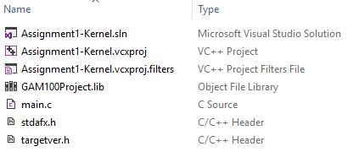
Sample Visual Studio Project
Open the “Assignment1-Kernel” folder:
Double-click “Assignment1-Kernel.sln”

Slide 5
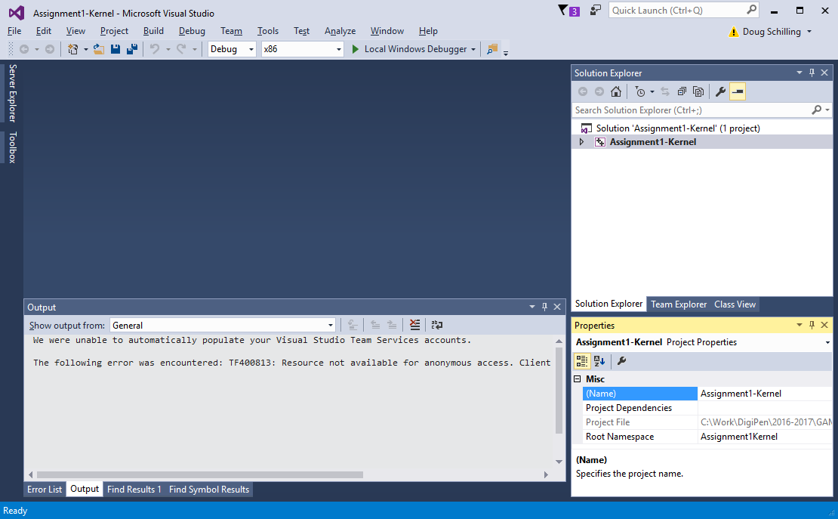

Slide 6
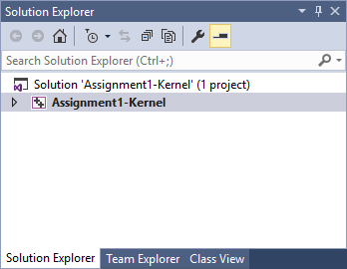
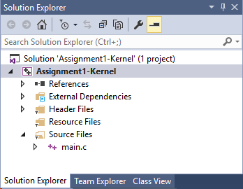
Solution Explorer
Provides a “tree view” of the entire “solution”
Note: A solution can contain multiple projects
Useful for managing large applications
Each project creates a .lib, .dll, or .exe file

Slide 8
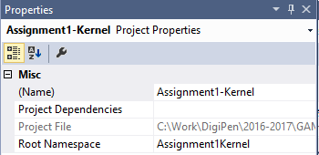
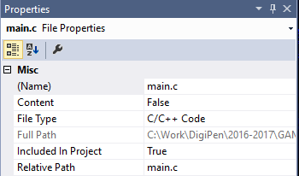
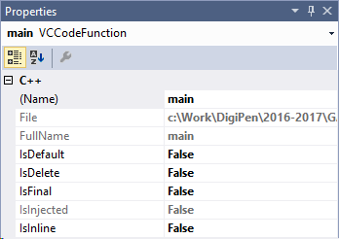
Properties View
Provides context-sensitive information on
Projects
Files
Functions
Etc.

Slide 9
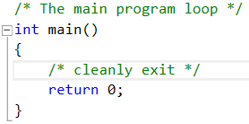
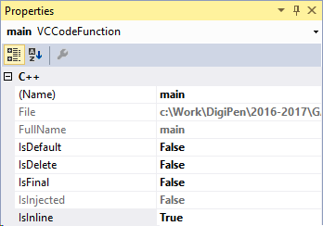
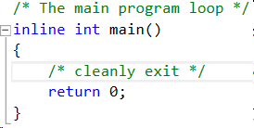
Properties View
Allows properties to be changed

Slide 11
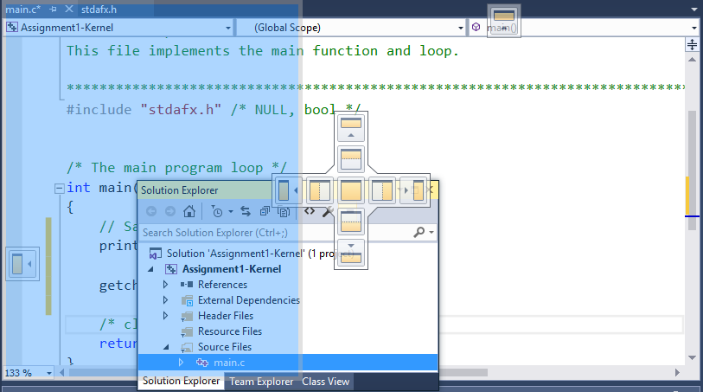
Dockable Windows
Windows may be repositioned and resized

Slide 12
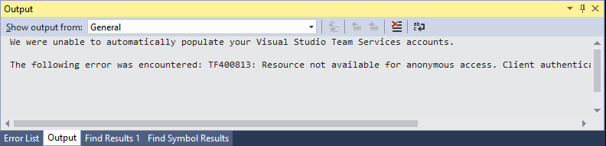
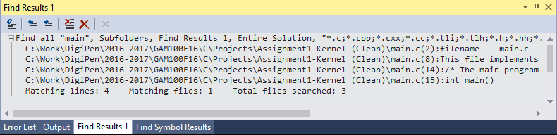
Dockable Windows
Windows may be docked together (“tabbed docking”)

Slide 13
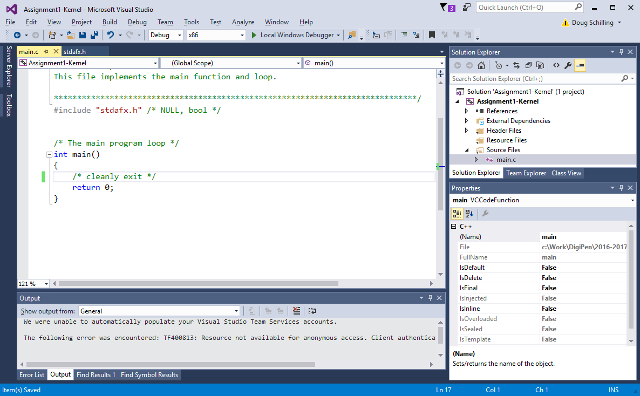

Slide 14
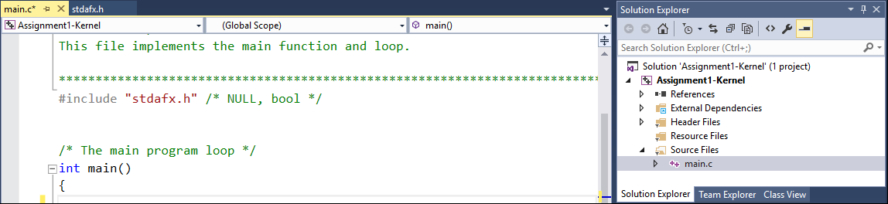
Text Editor
Multiple files can be opened simultaneously
Each file is displayed in a separate dockable window

Slide 15
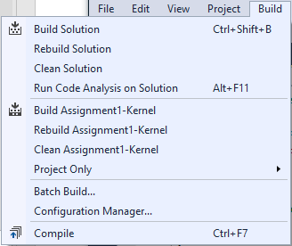
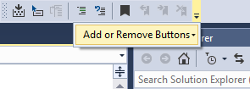
Building / Compiling
There are multiple options for building / compiling
Drop-down menus
Short-cuts
Ctrl+Shift+B
F5 (“Build and Run”)
Configurable buttons

Slide 16

Build Configurations
Debug
More error checking
Non-optimized code
Slower!
Release
Less error checking, typically
Optimized code – harder to debug
Faster!

Slide 17
Build Configurations
x86 applications
Use 32-bit instructions
64-bit CPU’s are backwards-compatible with 32-bit apps
x64 applications
Use 64-bit instructions
Require 64-bit CPU and Operating System (OS)
Use the x86 option for maximum compatibility

Slide 19
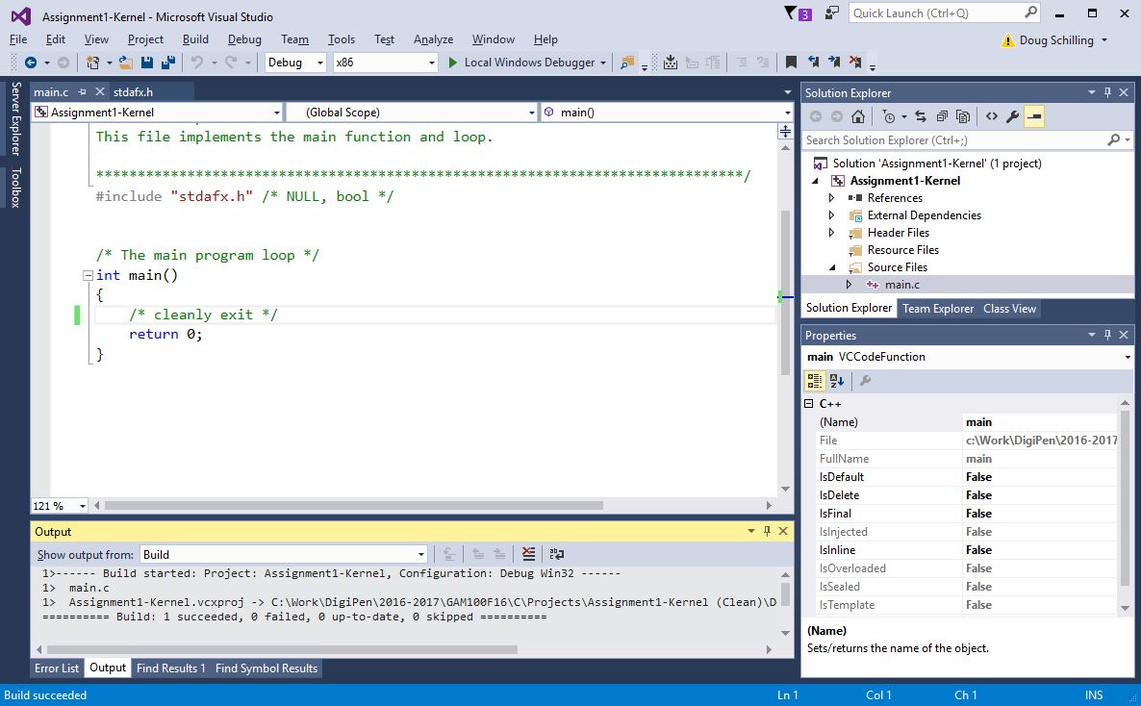

Slide 20
How do you find bugs in your code?
Code inspection
Relies on flawed assumptions
“printf” debugging
Relies on guesswork
Relies on liberal use of printf statements
Use a debugger
Shows exactly what is happening
Has powerful features for analyzing code and detecting errors

Slide 21
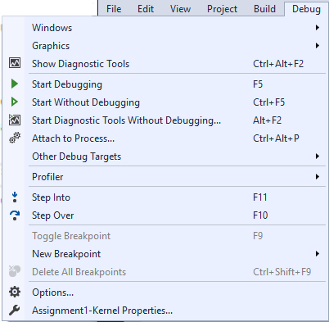

Slide 22
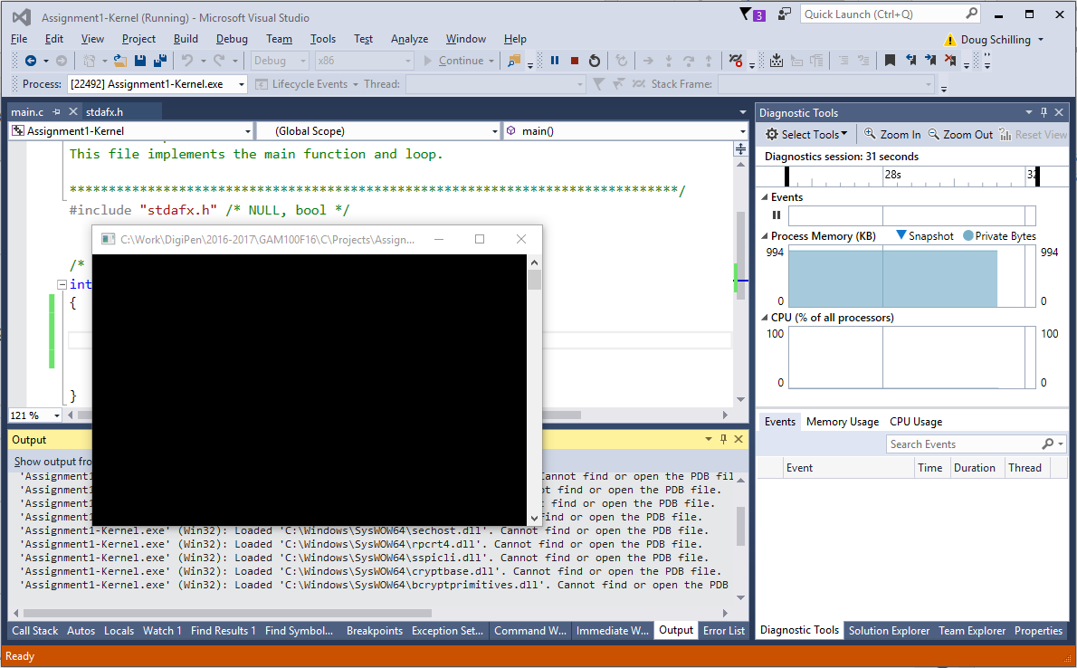

Slide 23
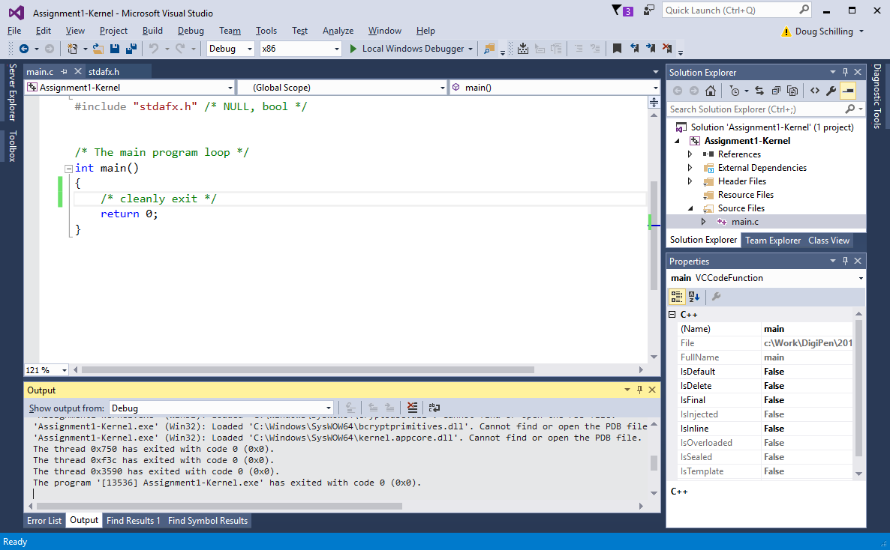

Slide 24
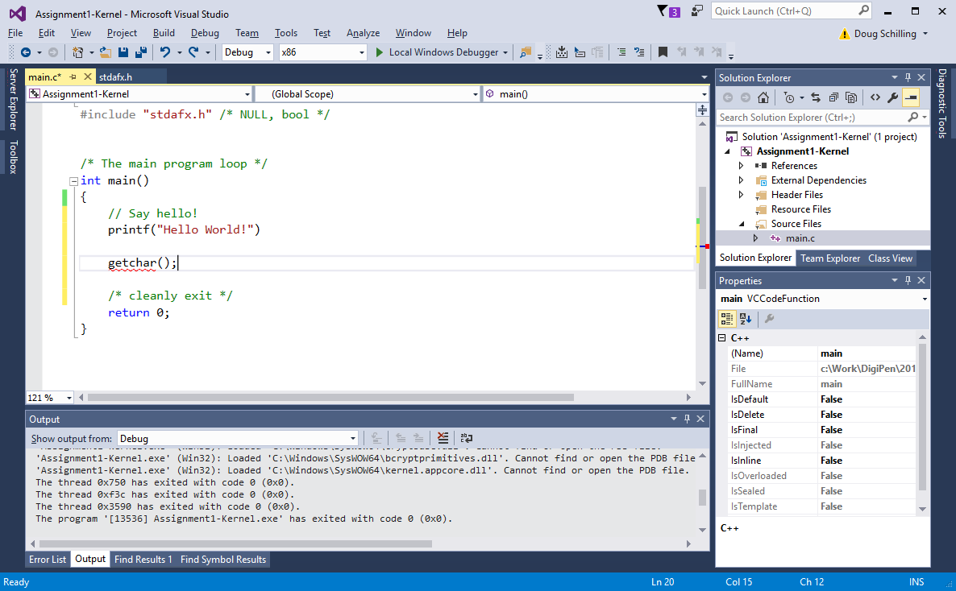

Slide 25
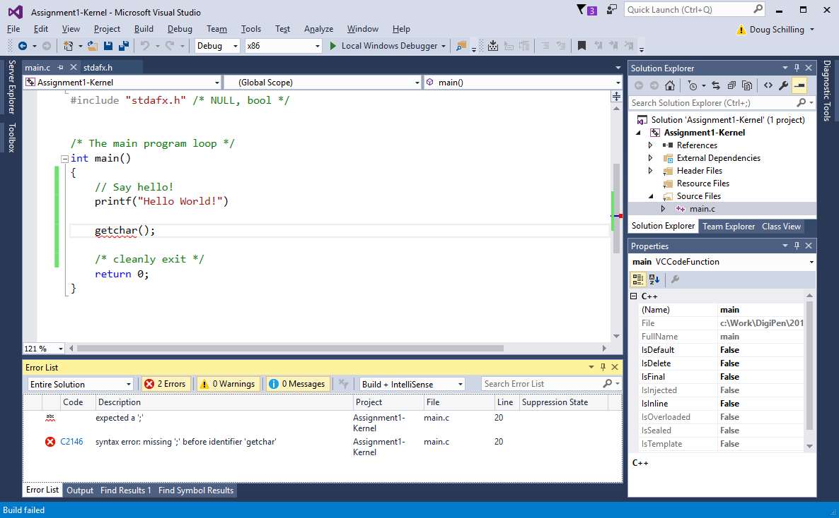

Slide 26
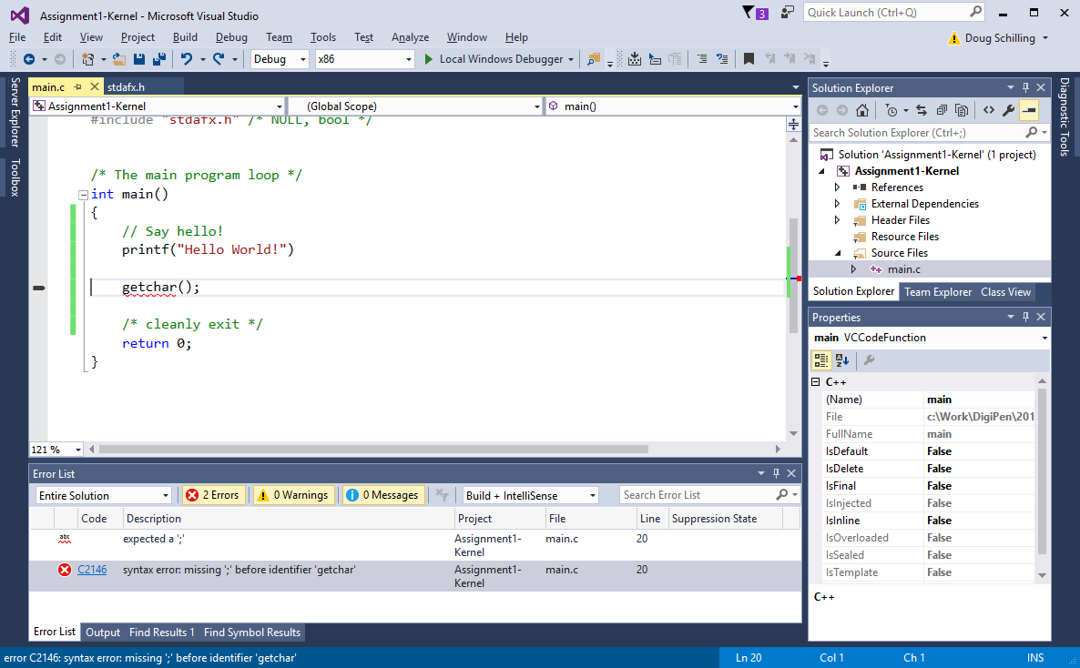

Slide 27
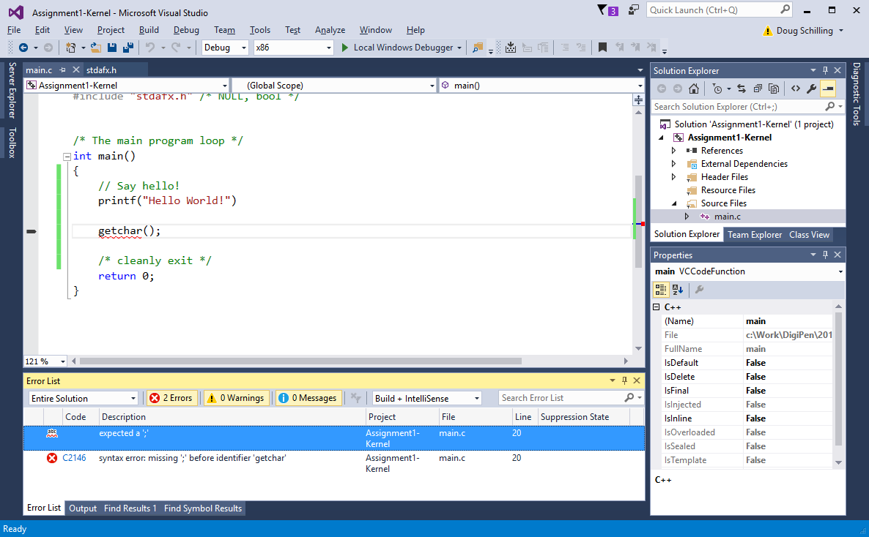

Slide 28
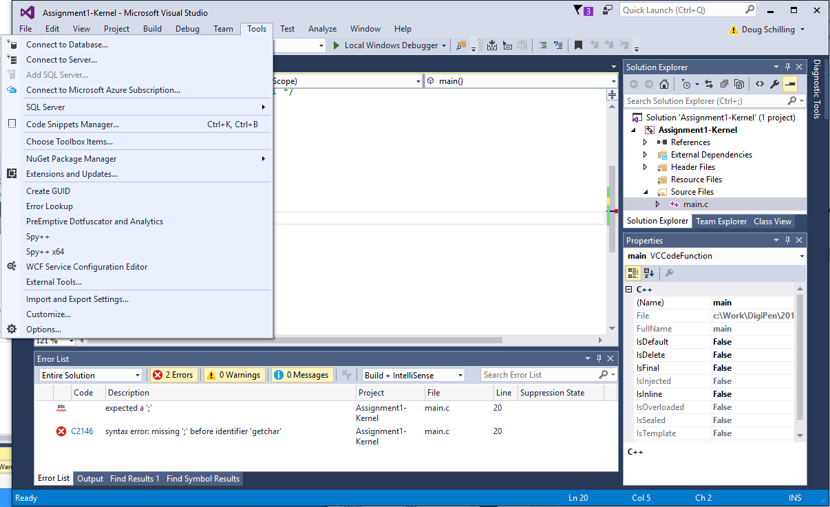

Slide 29
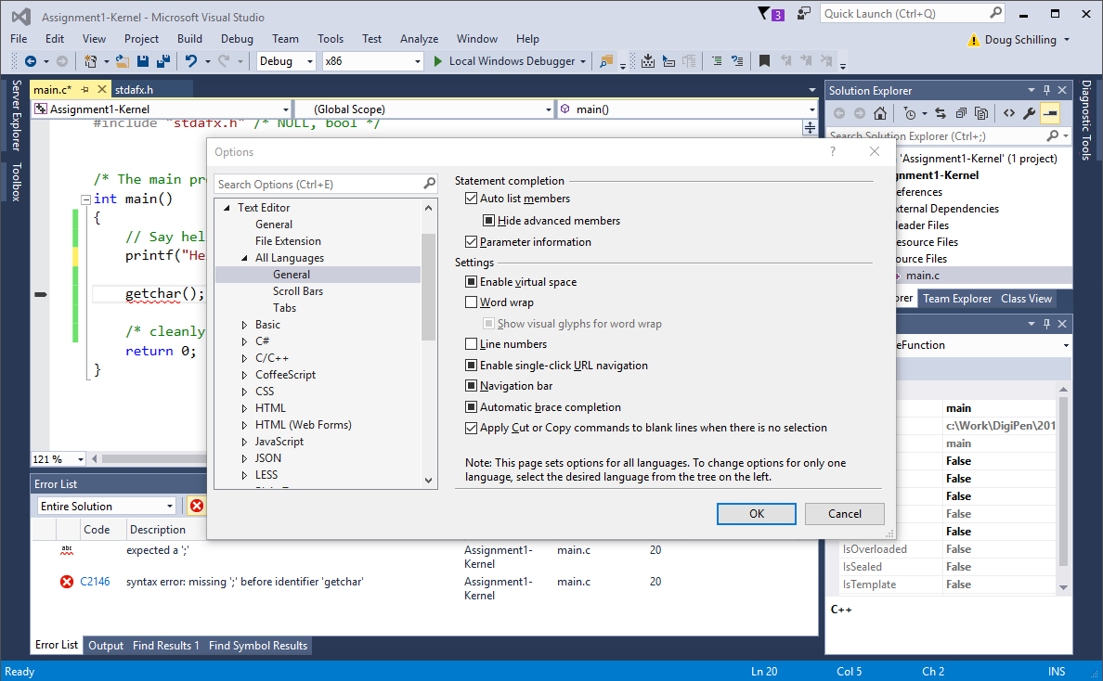

Slide 30
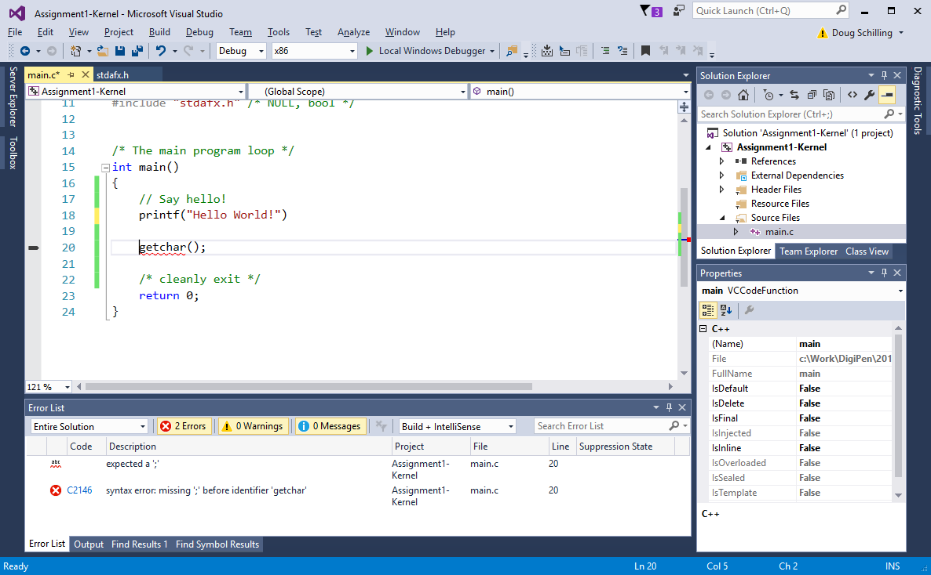

Slide 31
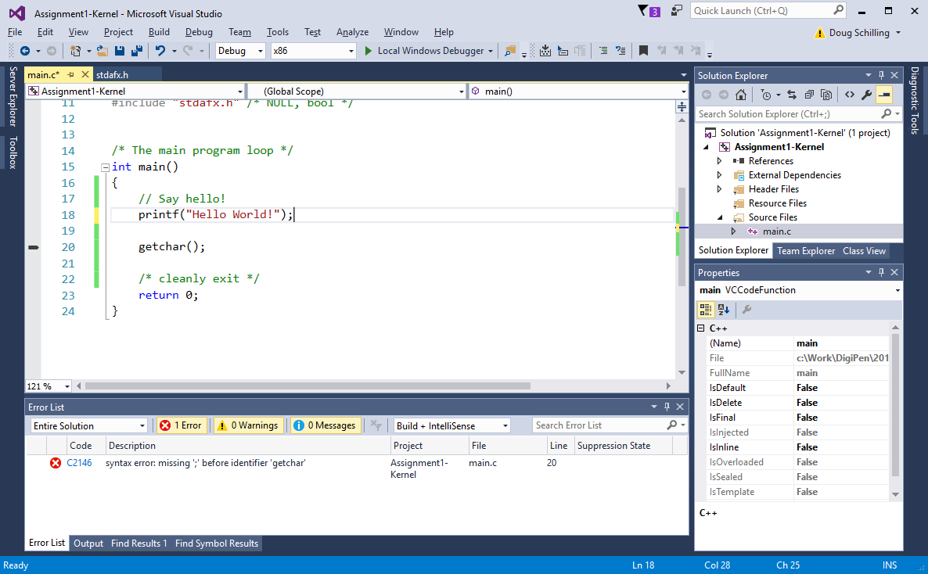

Slide 32
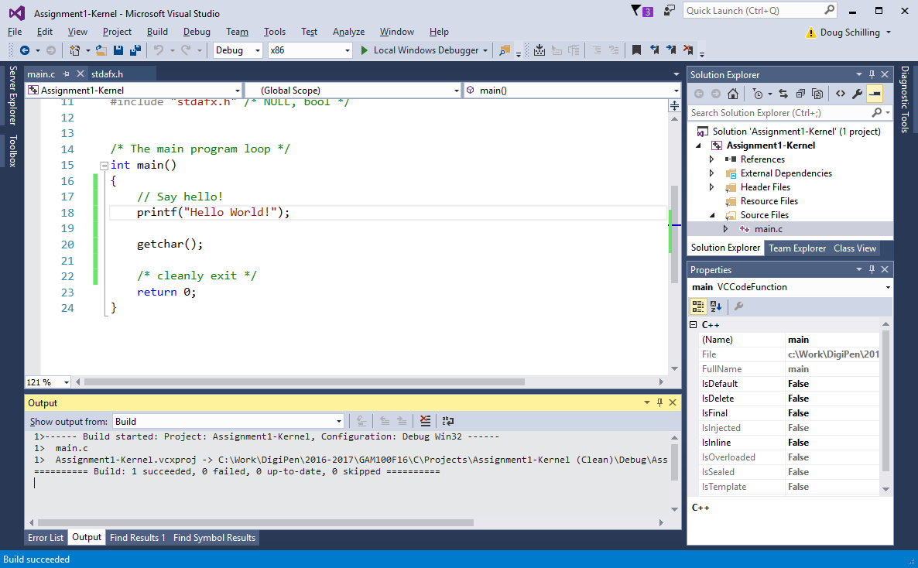
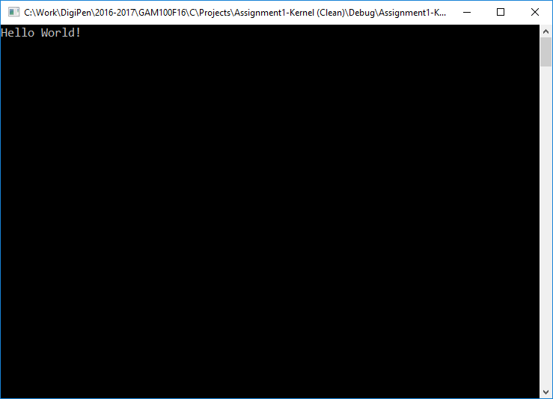

Slide 33
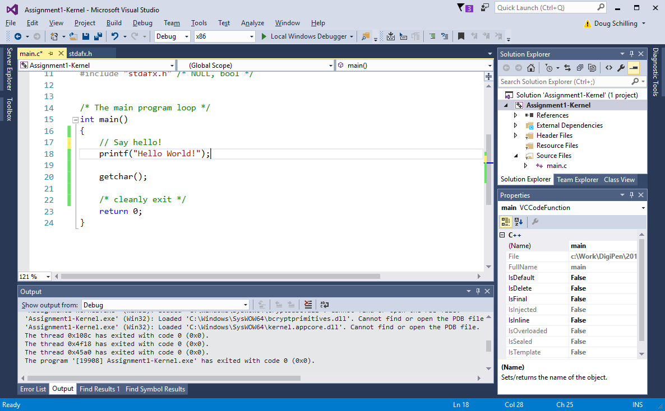

Slide 34
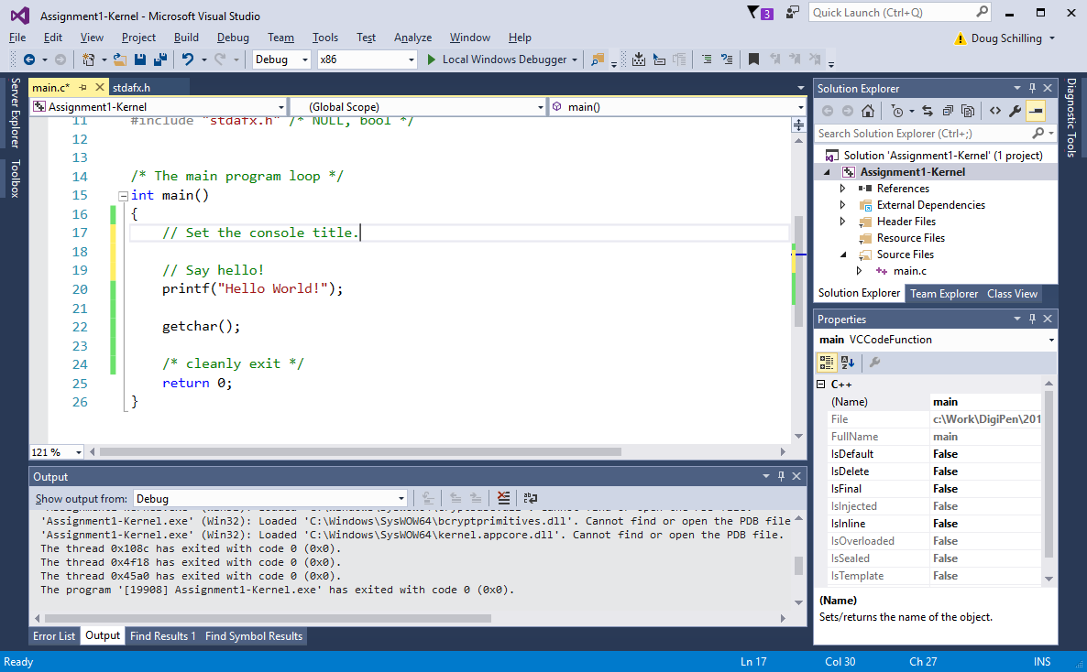

Slide 35


Slide 36
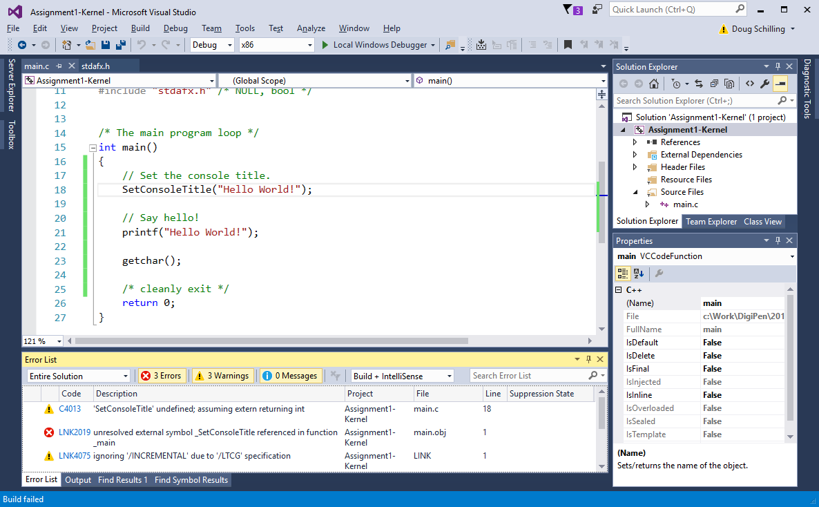

Slide 37
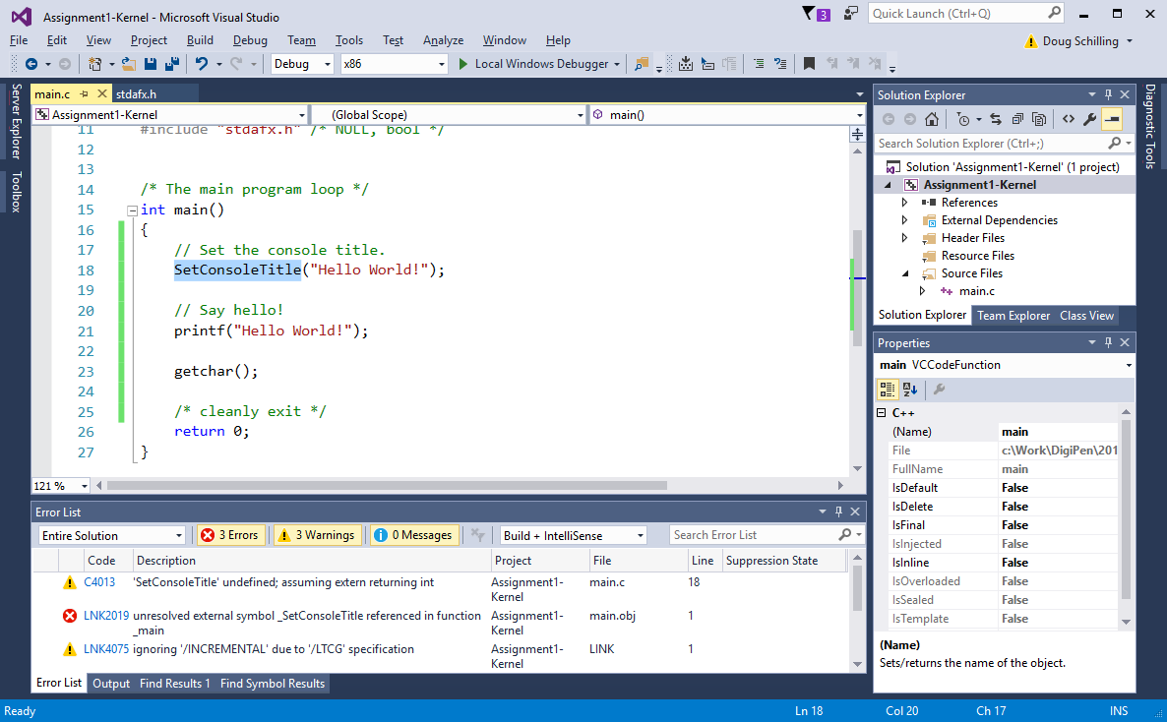
Press <F1>

Slide 38
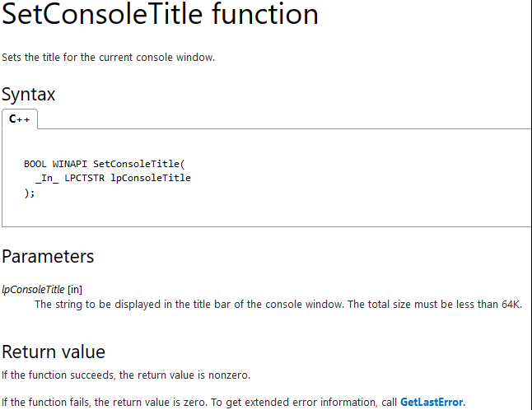

Slide 39
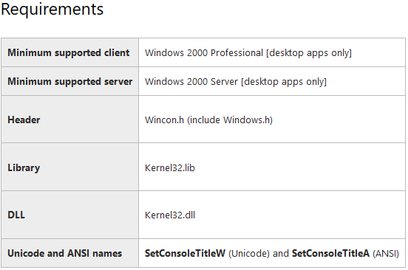

Slide 40
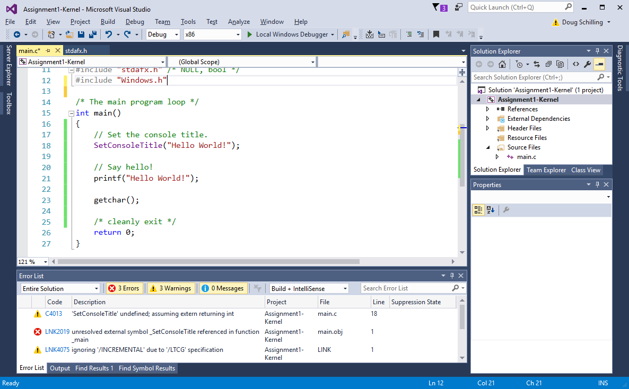

Slide 41
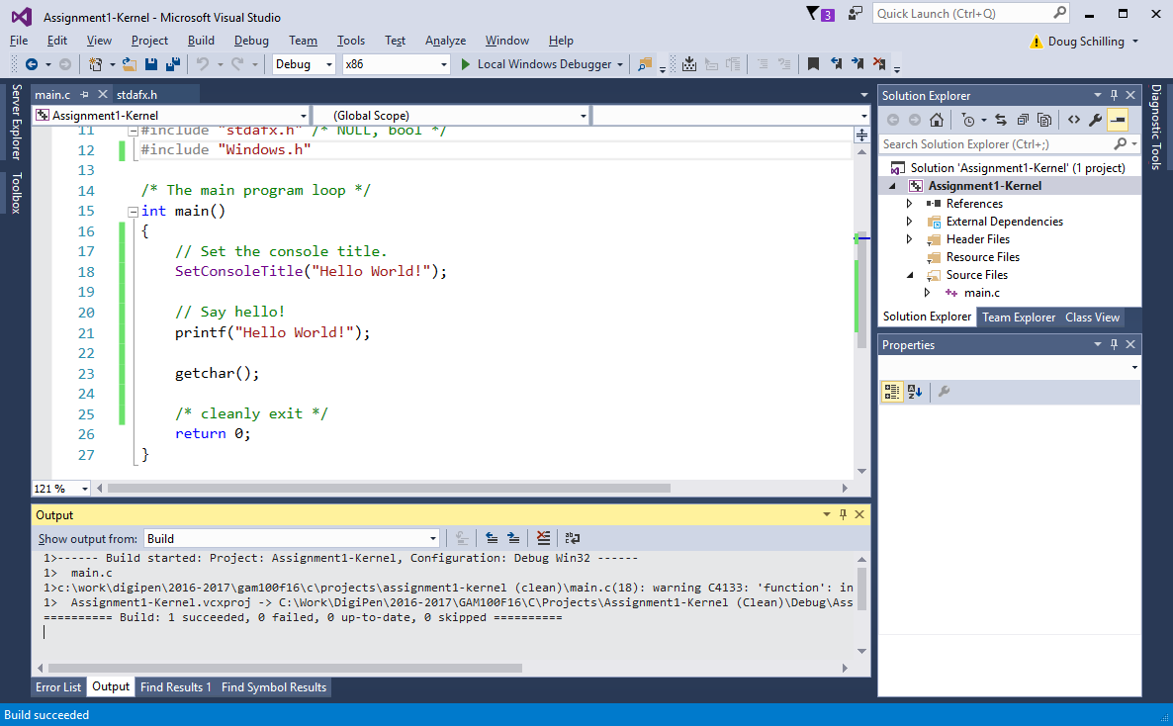
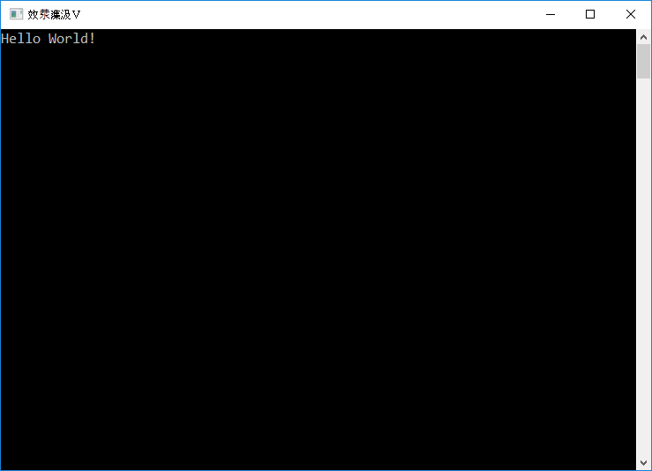

Slide 42
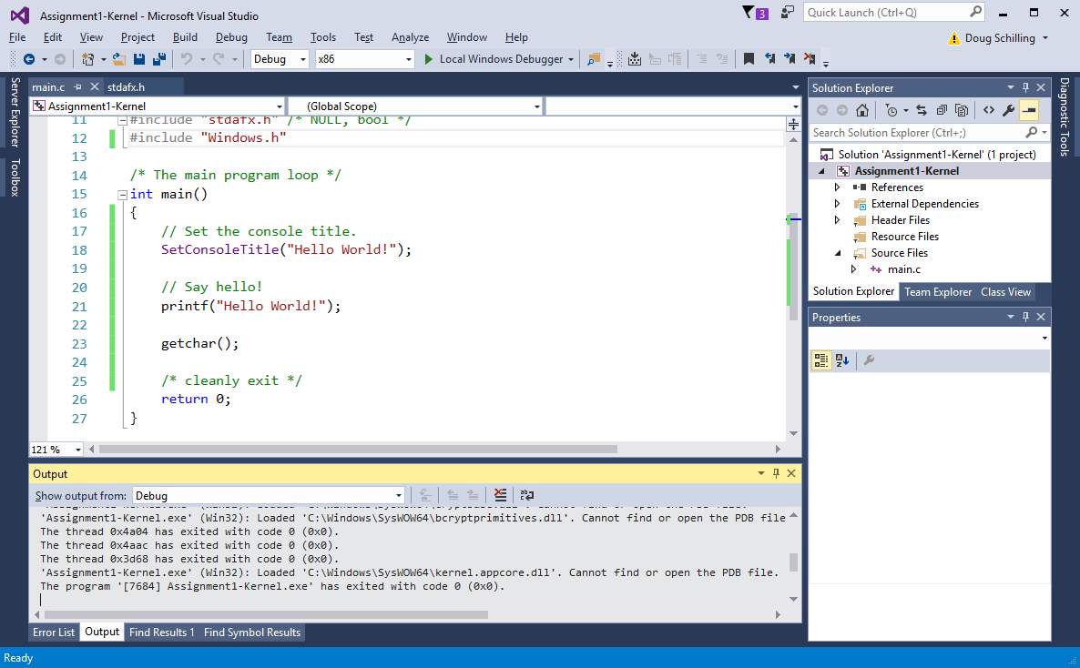

Slide 43

warning C4133: 'function': incompatible types - from 'char [13]' to 'LPCWSTR'

Slide 44
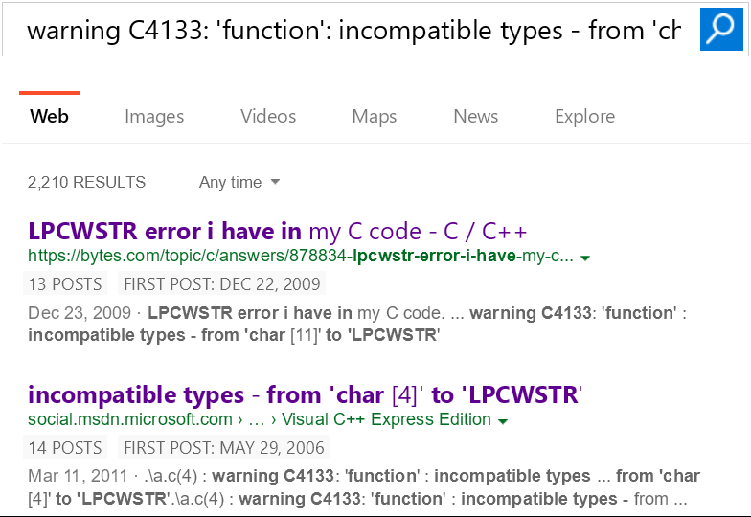

Slide 45
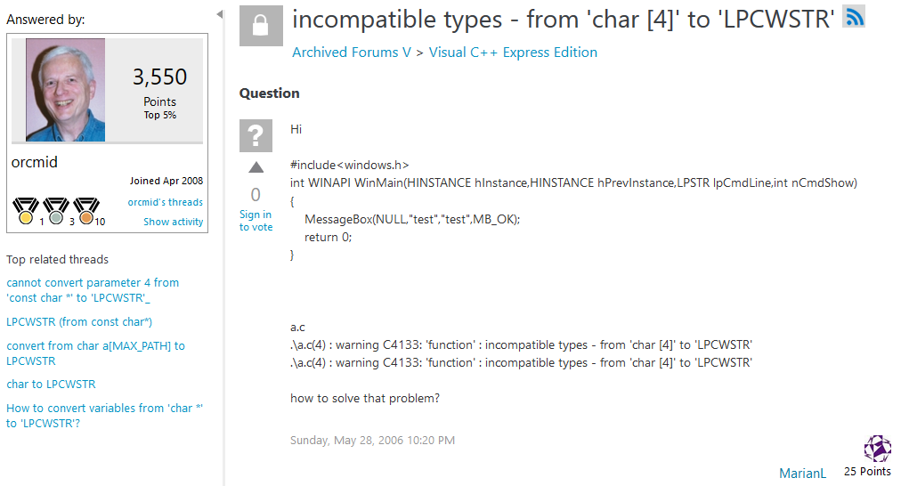

Slide 46
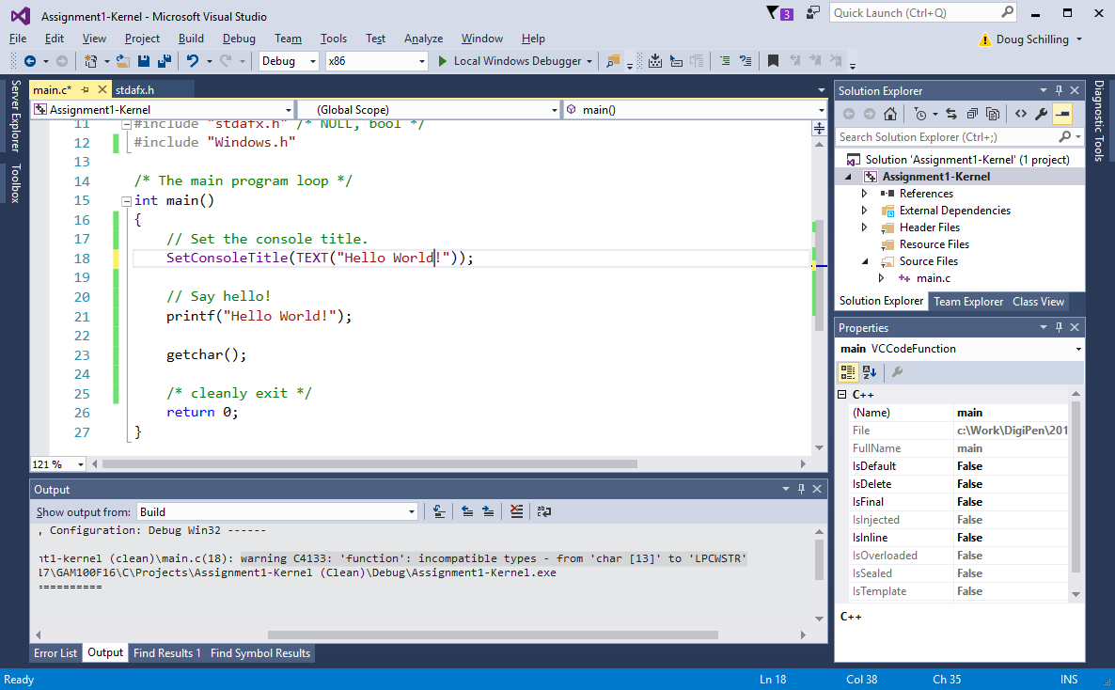

Slide 47
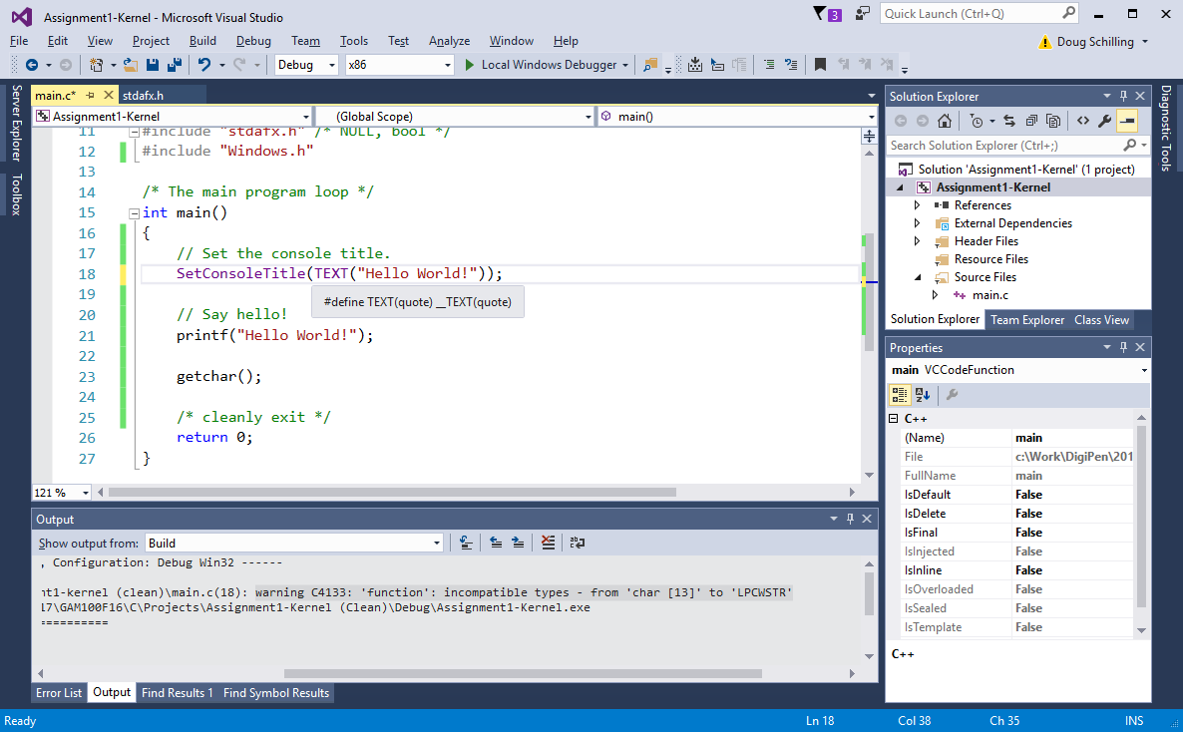

Slide 48
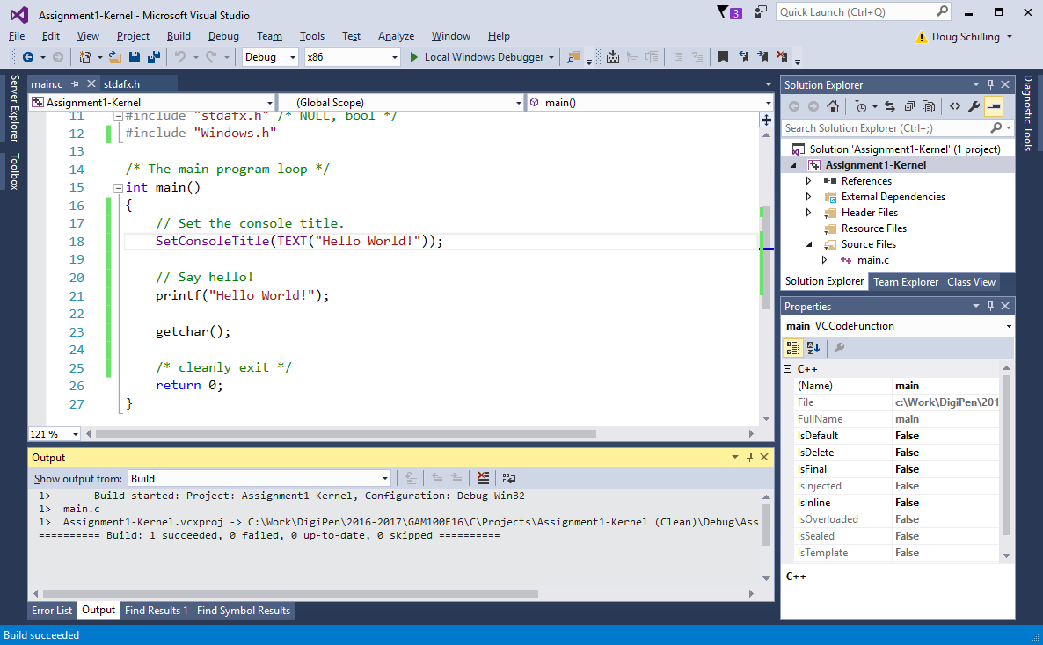
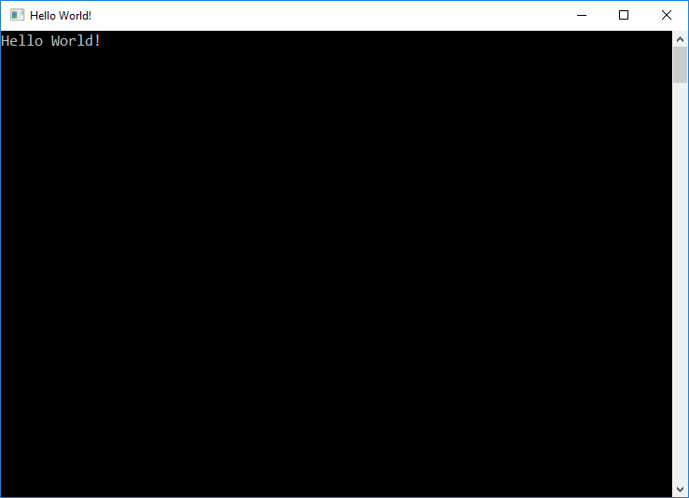

Slide 49
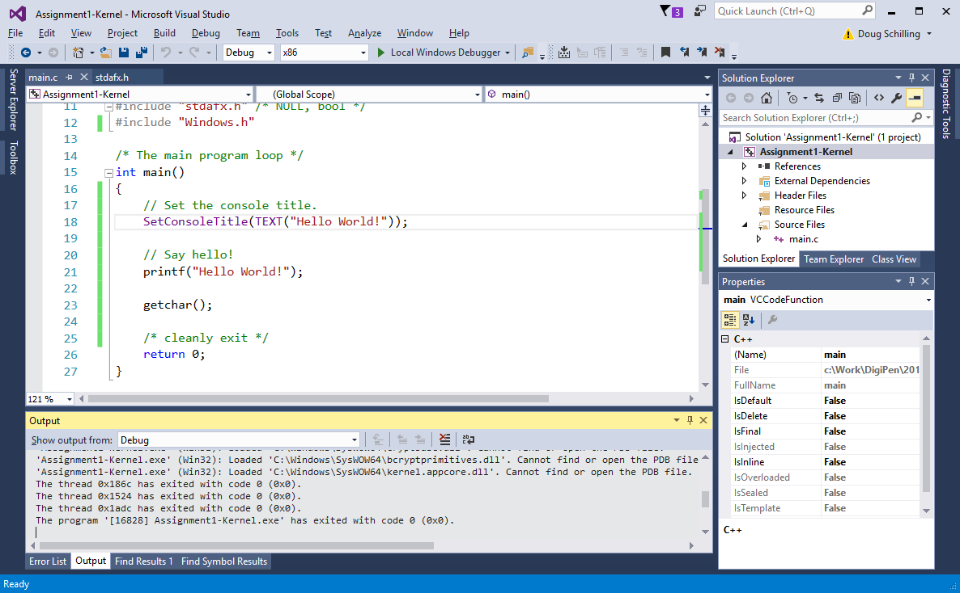

Slide 50
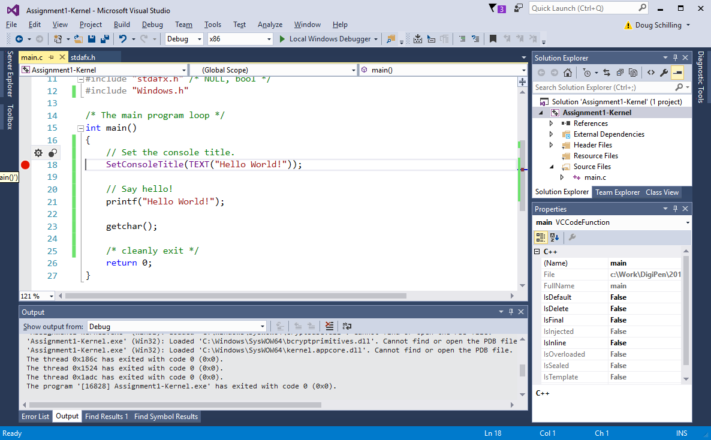

Slide 51
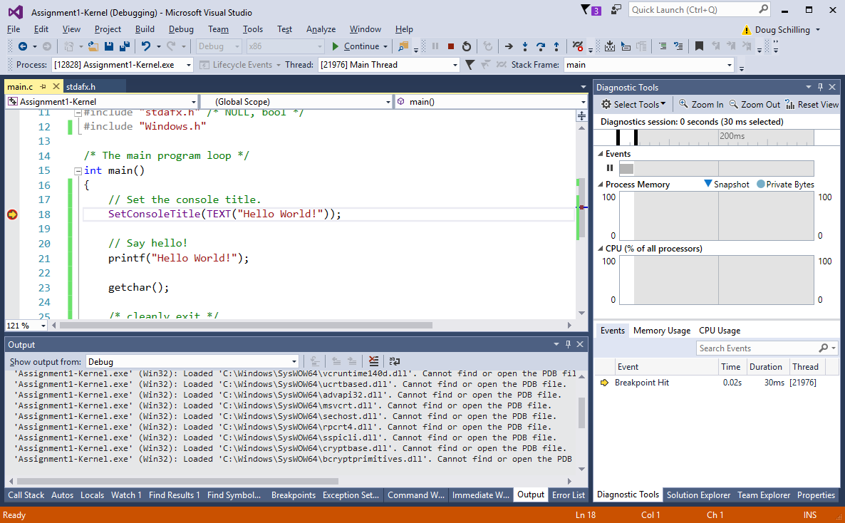

Slide 52


Slide 53


Slide 54
Introduction to Visual Studio
Questions?

